Slide 1
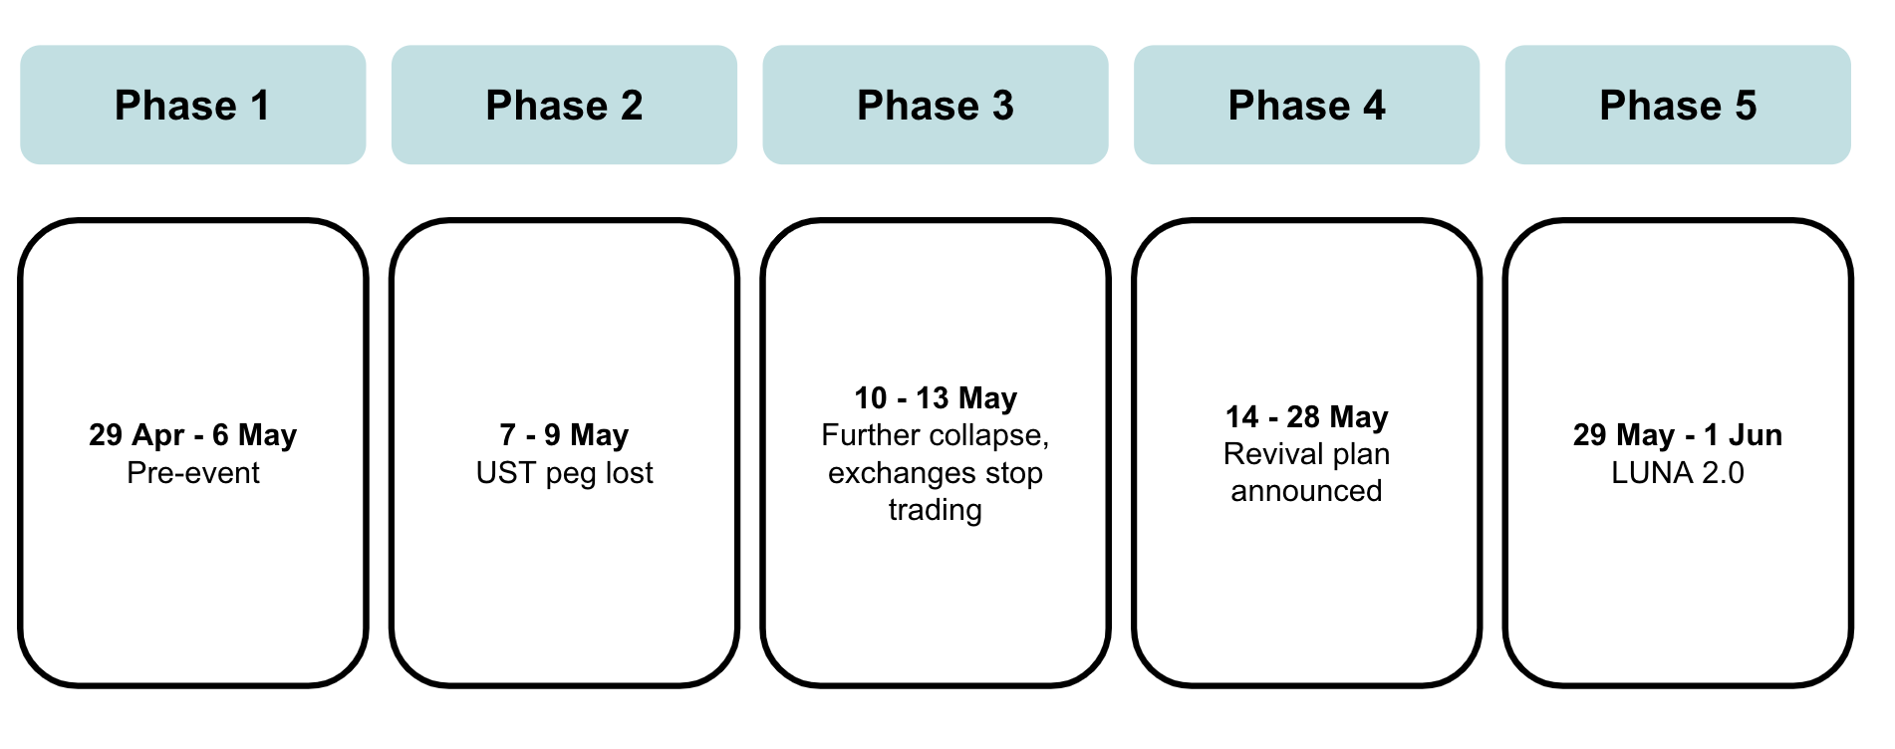
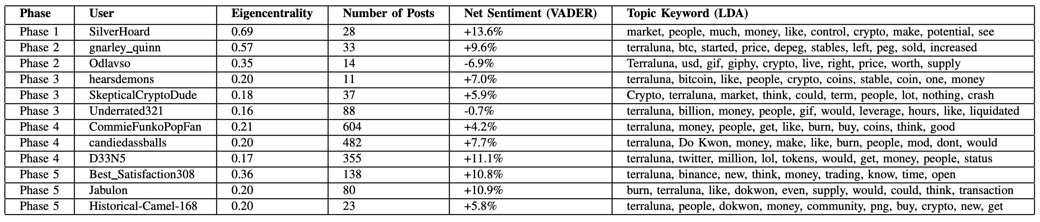
Reddit Submissions Topic Modelling and Sentiment Analysis on Collapse of Terra (LUNA) Event
Shilton Jonatan SALINDEHO
sjsalindeho.2020@msc.smu.edu.sg
MOTIVATION
This project focuses on studying the impact of the collapse of the Terra (LUNA) blockchain protocol on Reddit users' social posting habits and attitudes.
Social media, as a platform for sharing various types of information and knowledge, provides valuable insights into people's thoughts and feelings
Reddit, being highly active in discussions about the crypto space, offers a unique opportunity for topic-specific analyses of users' attitudes due to its subreddit feature
The study analyzed users' posts through topic modeling and examine the sentiments expressed to understand how the event affected communication and interactions within the community
TIMELINE
Based on how the submissions and comments grew and fell, and how the price of both LUNA and UST collapsed within the month, the whole data can then be roughly split into five distinct phases.
METHODOLOGY
CONCLUSION
Social Network Analysis (Eigenvector Centrality)
The collapse of the Terra (LUNA) blockchain protocol provided a significant opportunity to understand network structures and user sentiments in the cryptocurrency community. Valuable insights were gained into the behavior of influential users during crises, emphasizing the importance of thoughtful contributions in the crypto space.
Throughout the event, the network structure underwent changes, giving rise to influential users who shaped the discussed topics. Generally, as discussion volume increased, more central figures joined, but there were exceptions. Phase 4 was notable for top users maintaining a strong presence throughout the timeline, despite Phase 3 having the highest daily discussions.
Interestingly, these top users expressed their thoughts clearly and comprehensively, rather than displaying extreme sentiment polarities. Analyzing all phases revealed that the overall sentiments of these users tended to be mostly positive, albeit slightly. Their language usage showcased expertise and active engagement with the topics at hand.
Data Retrieval from Reddit (PSAW and PRAW)
Data Preprocessing
Sentiment Analysis (VADER)
Topic Analysis (Latent Dirichlet Allocation)
Firstly, data retrieval was done using PSAW and PRAW packages for Reddit data on Python. Then, data is preprocessed accordingly. Afterwards, these analysis are done to the processed data:
Identification of influential and top users within the subreddit discussions
Sentiment and topic analysis of submissions and comments data around these top users.
Establish the link between these topics and sentiments analysis with the movement of LUNA's price, thereby understanding how social media users respond to significant price fluctuations.
FINDINGS – TOP USERS
In earlier phases where event has not taken place yet shows less numbers of influential users, while further down the line where collapse eventually peaked and revival plans were announced, more top users emerged.
ACKNOWLEDGEMENT & REFERENCES
M. C. Meacham, M. J. Paul, and D. E. Ramo, “Understanding emerging forms of cannabis use through an online cannabis community: an analysis of relative post volume and subjective highness ratings,” Drug and alcohol dependence, vol. 188, pp. 364–369, 2018. M. Glenski, E. Saldanha, and S. Volkova, “Characterizing speed and scale of cryptocurrency discussion spread on reddit,” in The World Wide Web Conference, 2019, pp. 560–570. E. Kereiakes, D. Kwon, M. D. Maggio, and N. Platias, “Terra money: Stability and adoption,” White Paper, Apr, 2019

